Slide 1
Medical question answering systems
John Patrick Amata
Immanuel Espiritu
Jayvee Febrer

Slide 2
Background
What is Question Answering (QA)? It is a computer science discipline within the fields of information retrieval and natural language processing (NLP), which is concerned with building systems that automatically answer questions posed by humans in a natural language. A QA Implementation, usually a computer program, may construct its answers by querying a structured database of knowledge or information, usually a knowledge base. More commonly, QA systems can pull answers from an unstructured collection of natural language documents. (s. Handbook Of Knowledge Representation: Communication, Information Science - 2016)

Slide 3
Background
The medical profession requires a great deal of memorization and information retrieval of medical texts. Doctors and physicians often need to refer to medical documents and most get theirs from the internet. Due to their profession, time is of great essence. The promising values that Medical Q&A systems bring is the quick retrieval of information from a set of documents as queried from a natural language form.

Slide 4
Objectives Significance Scope & Limitations
To experiment and study applicable trends in Question Answering and its application to a Medical Question Answering system.
To provide a modern model(s) of a question answering system for researchers and developers to follow in creating their own Medical Question Answering system.
We shall limit our scope on examining and experimenting with Factoid Question Answering systems. For the context of our corpus, we shall gather questions about Diabetes. With these serving as our usage context, we shall compare the results between two methods of Question-Answering: Traditional Information Retrieval and Neural Networks.

Slide 5
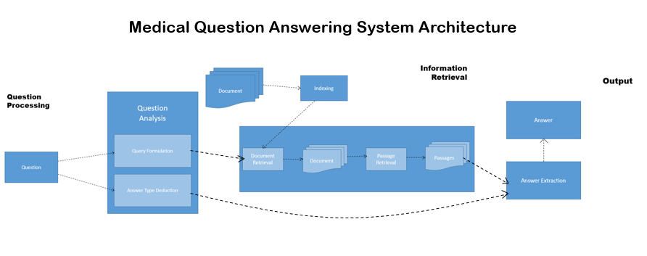
Design and Methodology

Slide 6
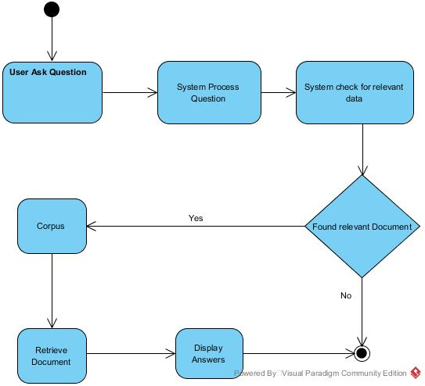
Activity Diagram

Slide 7
Semantic Model
For our set of questions, we modeled the form of each question to the following semantic patterns so as to identify regularities and model their semantic contents. These patterns were obtained by generalizing the canonical forms to generic categories of the domain.
What is [A]?
Is [A] [B]?
[A] which [B]?
Define [A]
Who is [A]?
When [A]?

Slide 8
Platform Analysis
OpenEphyra
QANUS
Quepy
Apache UIMA

Slide 9
First Cycle: Console Based QA
Developed from Sept-October
Results: Successfully parsed and classified 68% of our question set
Pitfalls: Text Retrieval
Utilised: Stanford CoreNLP

Slide 10
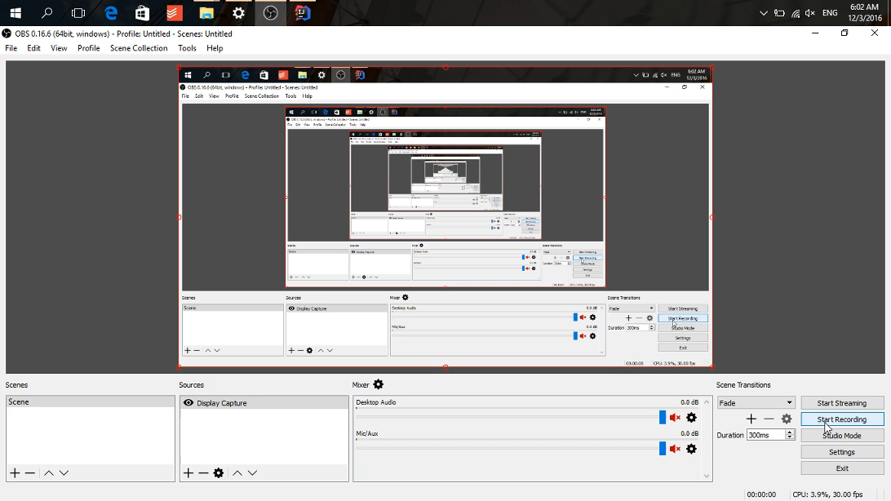
Console Based QA: Demo

Slide 11
Second Cycle: Browser Based QA
Developed during November
Solution for Information Retrieval
Populated with 100 Articles
Utilised: Elasticsearch, PHP, NlpTools (PHP API)
Pitfalls: Non-existing dictionary for named entities, coreferences, and the lack of deeper linguistic classification tools provides a weak passage ranking.

Slide 12
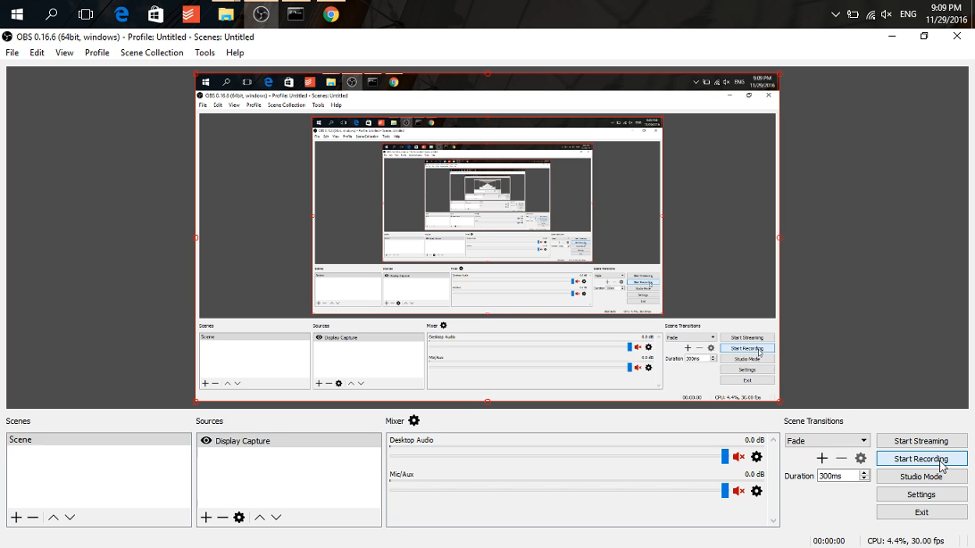
Browser Based QA: Demo

Slide 13
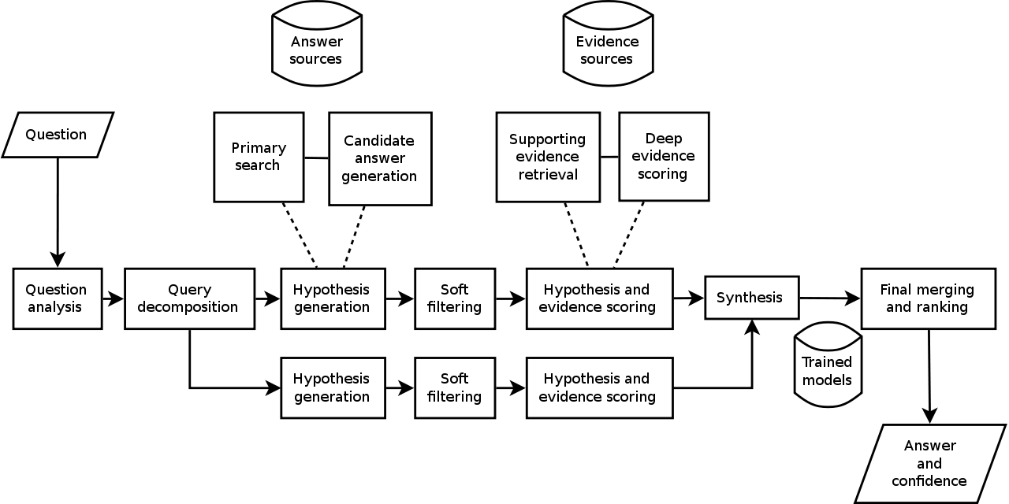
Third Cycle: Apache UIMA Based
Conception and Planning began on October
Started development on November

Slide 14
What’s Next?
Continue Traditional QA System development with a Apache UIMA based system
Develop models for passage ranking
Expand training data
Use the developed QA System on Cycle 2, and use it to develop an expert system
Shift from QA to an expert system
Shift from information retrieval to end to end memory networks

